Slide 1
Network Programming
(CSIZC462/ISZC462/SSZC462)
Assignment Phase 2
Satish Y (2024MT13013) & Prabhath K (2025HT66024)
Instructor In-Charge (I/C): Prof. Vivekananda M R

Slide 2
Smart Grid Energy Monitoring and Distribution System
Notes:
‹#›

Slide 3
Problem Statement
Design a real-time smart grid monitoring system using IPC and sockets.
Aims to:
Real-time data monitoring and updates.
Efficient and reliable communication.
Detect anomalies or faults in the grid.
Provides scalability for large distributed systems.
The system focuses on real-time monitoring and fault detection using socket programming and IPC.

Slide 4
Literature Survey & Justification
Literature Survey
Integration of renewable energy sources increases grid complexity.
Use of smart meters and IoT devices for detailed data collection.
Application of load forecasting for demand–supply balancing.
Adoption of edge computing for faster local data processing.
Interoperability issues due to lack of standard protocols.
Justification
Demonstrates IPC usage for efficient data exchange.
Shows socket-based network communication between systems.
Ensures system reliability in real-time monitoring.
Provides practical implementation of network programming concepts.
Bridges theory and real-world application.

Slide 5
Research Gap
Most existing smart grid systems are complex and expensive for academic demonstration.
Limited focus on cost-effective implementations.
Need for clear, practical system designs for learning purposes.
Insufficient demonstration of real-time concepts in small-scale models.

Slide 6
Objectives
Develop sector-level processes to simulate grid components (sensors/substations)
Design a central server to collect, process, and monitor data.
Implement communication mechanisms between processes and server.
Enable real-time data exchange and updates.
Ensure efficient coordination between different system components.
Reliable TCP communication
Multi-client monitoring

Slide 7
Milestones & Development Journey
Phase 1: Planning Define system requirements, design architecture, and identify components
Phase 2: Implementation Develop sector processes, central server, and communication mechanisms
Phase 3: Testing Verify system functionality, data flow, and handle possible errors
Phase 4: Documentation Prepare reports, code documentation, and presentation materials

Slide 8
Requirements for Problem Solving
Hardware Requirements: Computer system with minimum 4GB RAM for smooth execution
Software Requirements: Linux Operating System for IPC support and process management
Programming Language: Python for implementing IPC and socket communication
Libraries & Tools: Socket libraries and IPC mechanisms (Pipes, Message Queues, Shared Memory)
System Components: Sector processes, central server, and communication modules
Functional Requirements: Real-time data transmission, monitoring, and fault detection

Slide 9
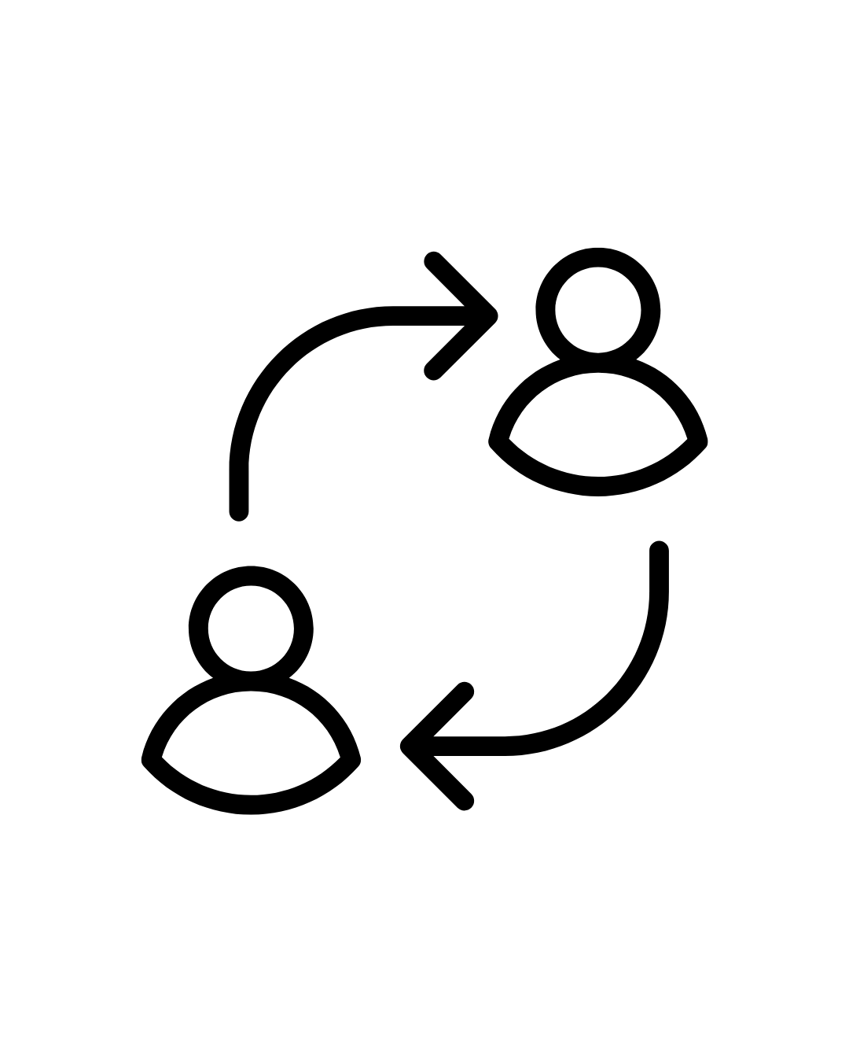
Roles & Responsibilities
Satish Y: Implementation of Inter-Process Communication (IPC) mechanisms.
Prabhath K: Development of socket-based communication and system testing.

Slide 10
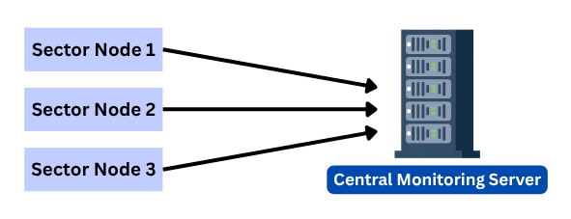
Proposed System Architecture
TCP socket communication
Real-time monitoring
Fault detection

Slide 11
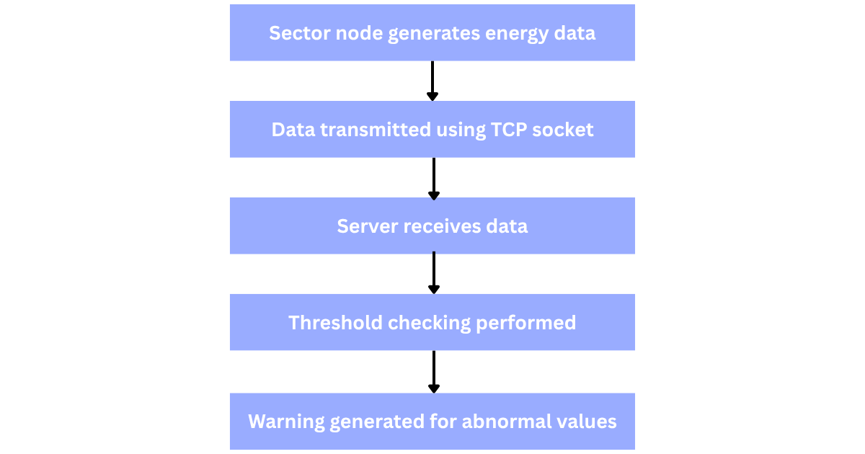
Workflow of System

Slide 12
Technologies Used
Technology | Purpose
Python | Programming
TCP Socket | Communication
Threading | Multiple clients
IPC | Process coordination

Slide 13
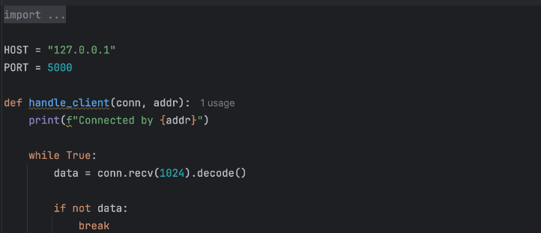
Implementation Details
Server module
Client module
Fault detection module
Multi-threading

Slide 14
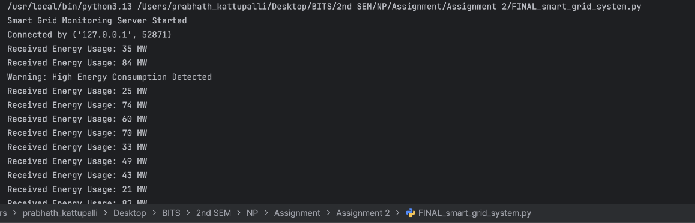
Testing and Results
Connection test successful
Continuous data transfer verified
Warning generation verified
Multiple clients supported

Slide 15
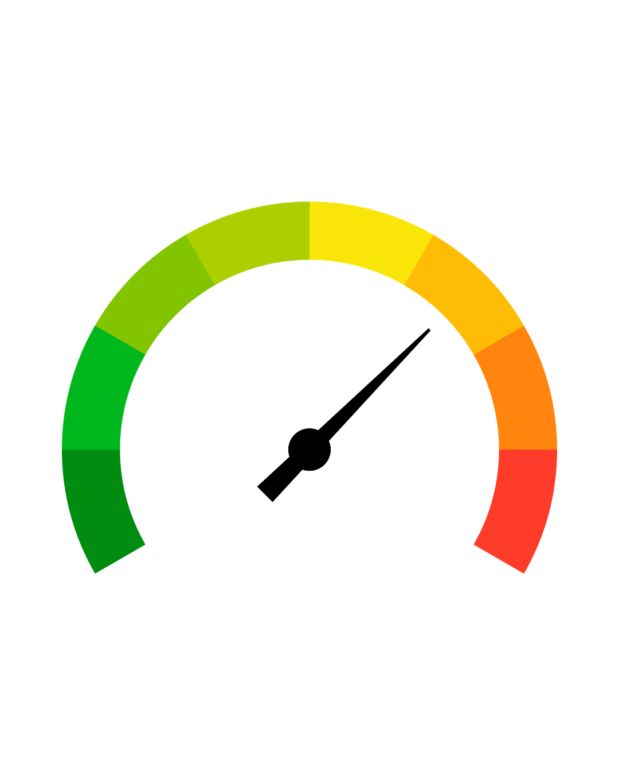
Performance Measurement
Reliable communication achieved
Fast data transfer
Low CPU usage
Continuous monitoring supported

Slide 16

Future Work
Cloud dashboard
IoT integration
AI-based analytics

Slide 17
Conclusion
The project successfully demonstrates real-time smart grid monitoring using TCP socket programming and IPC concepts. The system achieved reliable communication, fault detection, and centralized monitoring.

Slide 18

References
Python Documentation
Socket Programming Docs
Tanenbaum Computer Networks
Smart Grid Articles

Slide 19
Thank you

